Slide 1

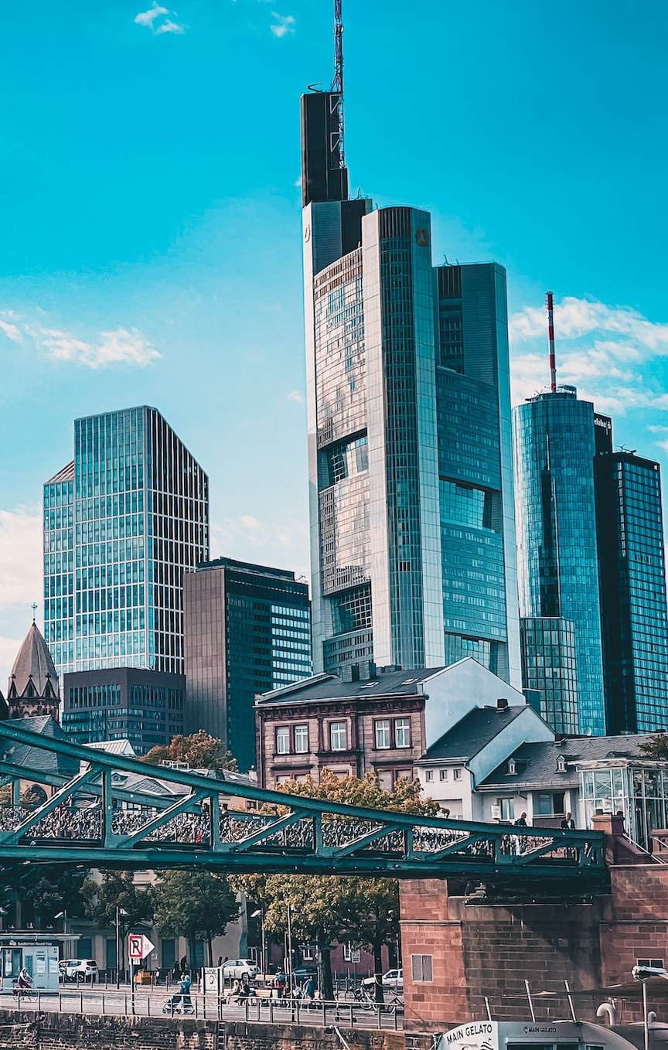

Deutschland
Frankfurt am Main
Das wirtschaftliche Zentrum Europas

Slide 2
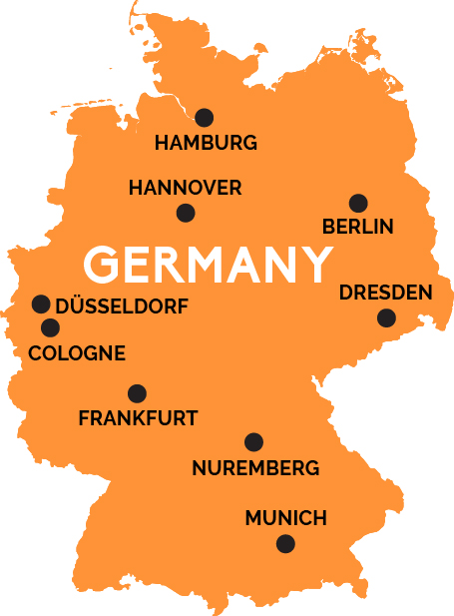
Geographie und Bevölkerung
Am Fluss Main
In der Mitte des Landes
Etwa 753 000 Einwohner

Slide 3

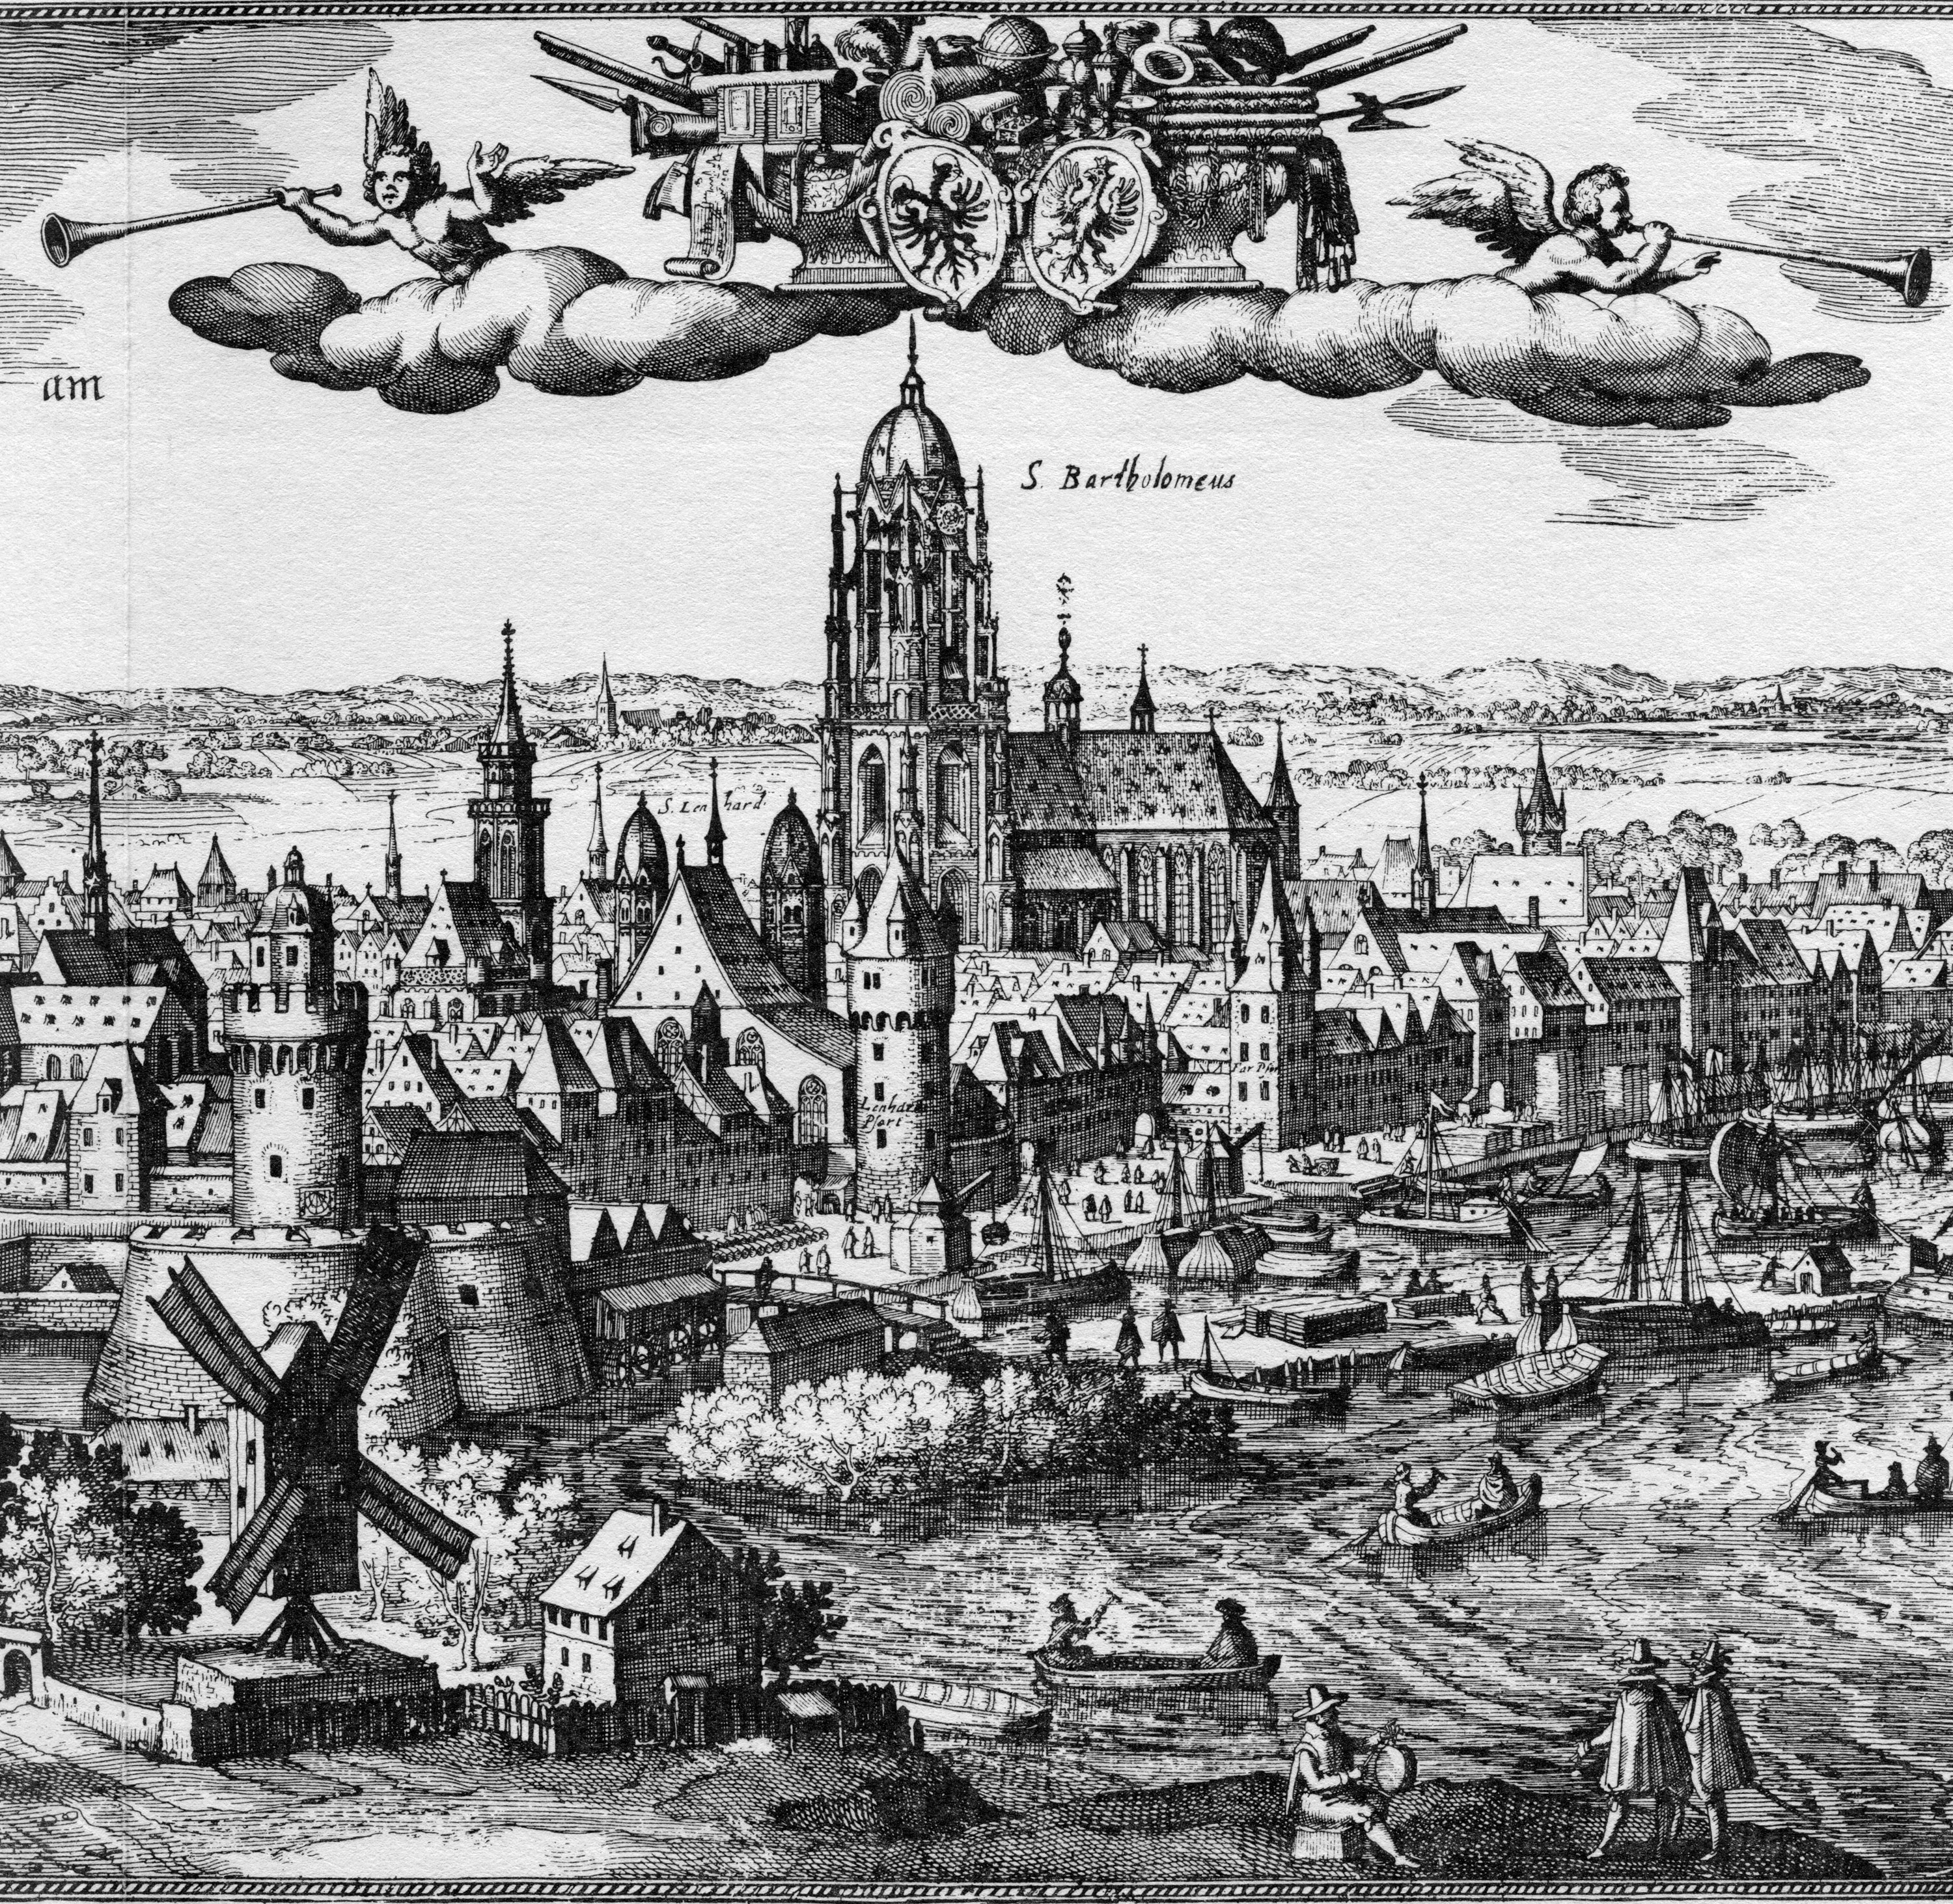
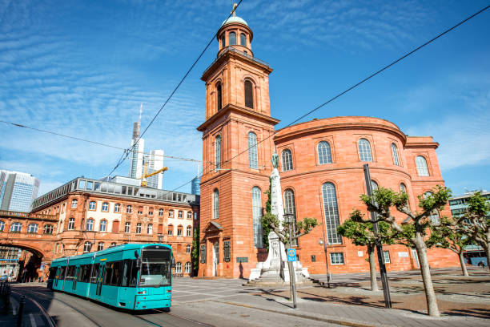
Warum Frankfurt?
Wirtschaft
Geschichte
Kultur

Slide 4

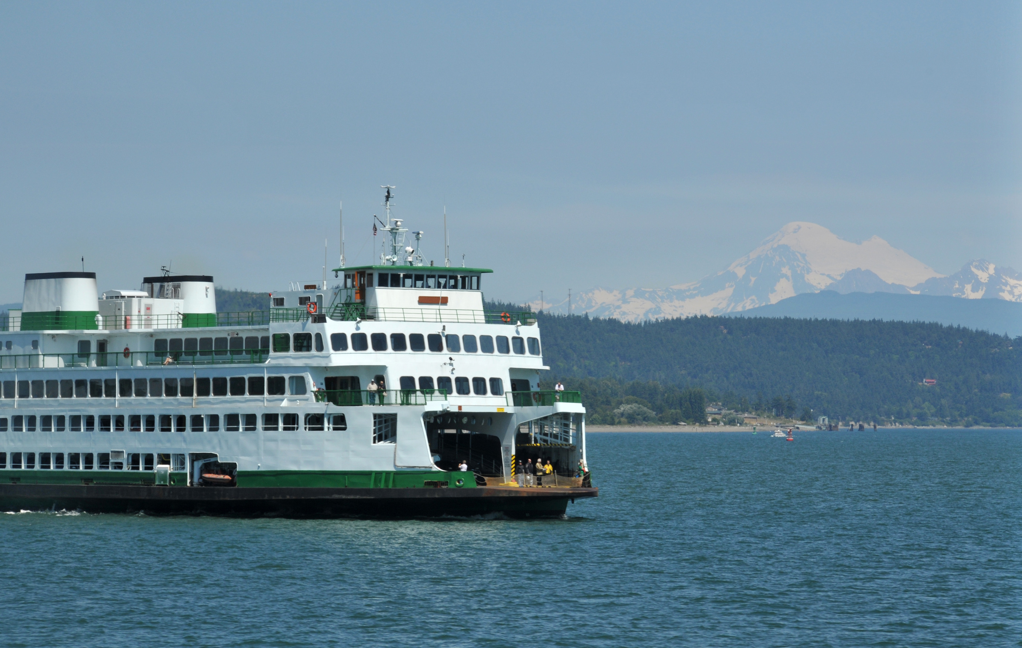
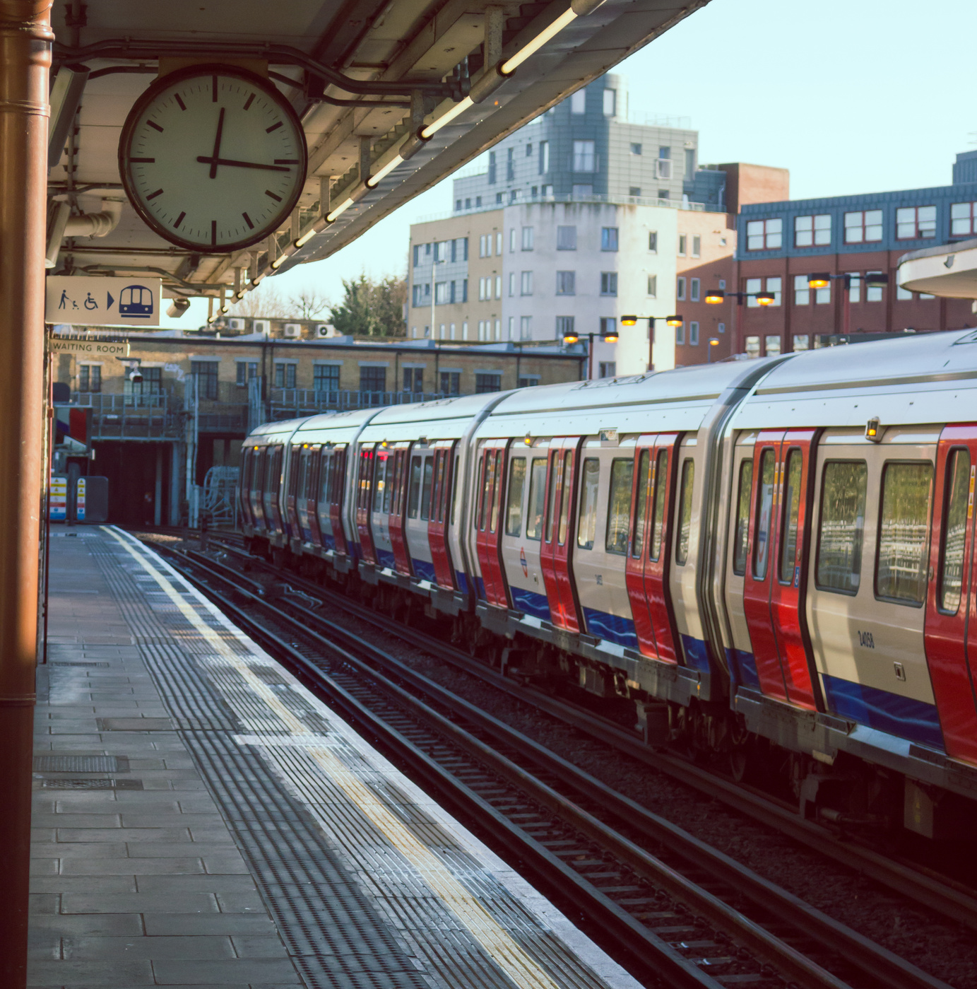

Berühmte Attraktionen
Presentations are communication tools that can be used as lectures, speeches, reports, demonstrations, and more.

Slide 5
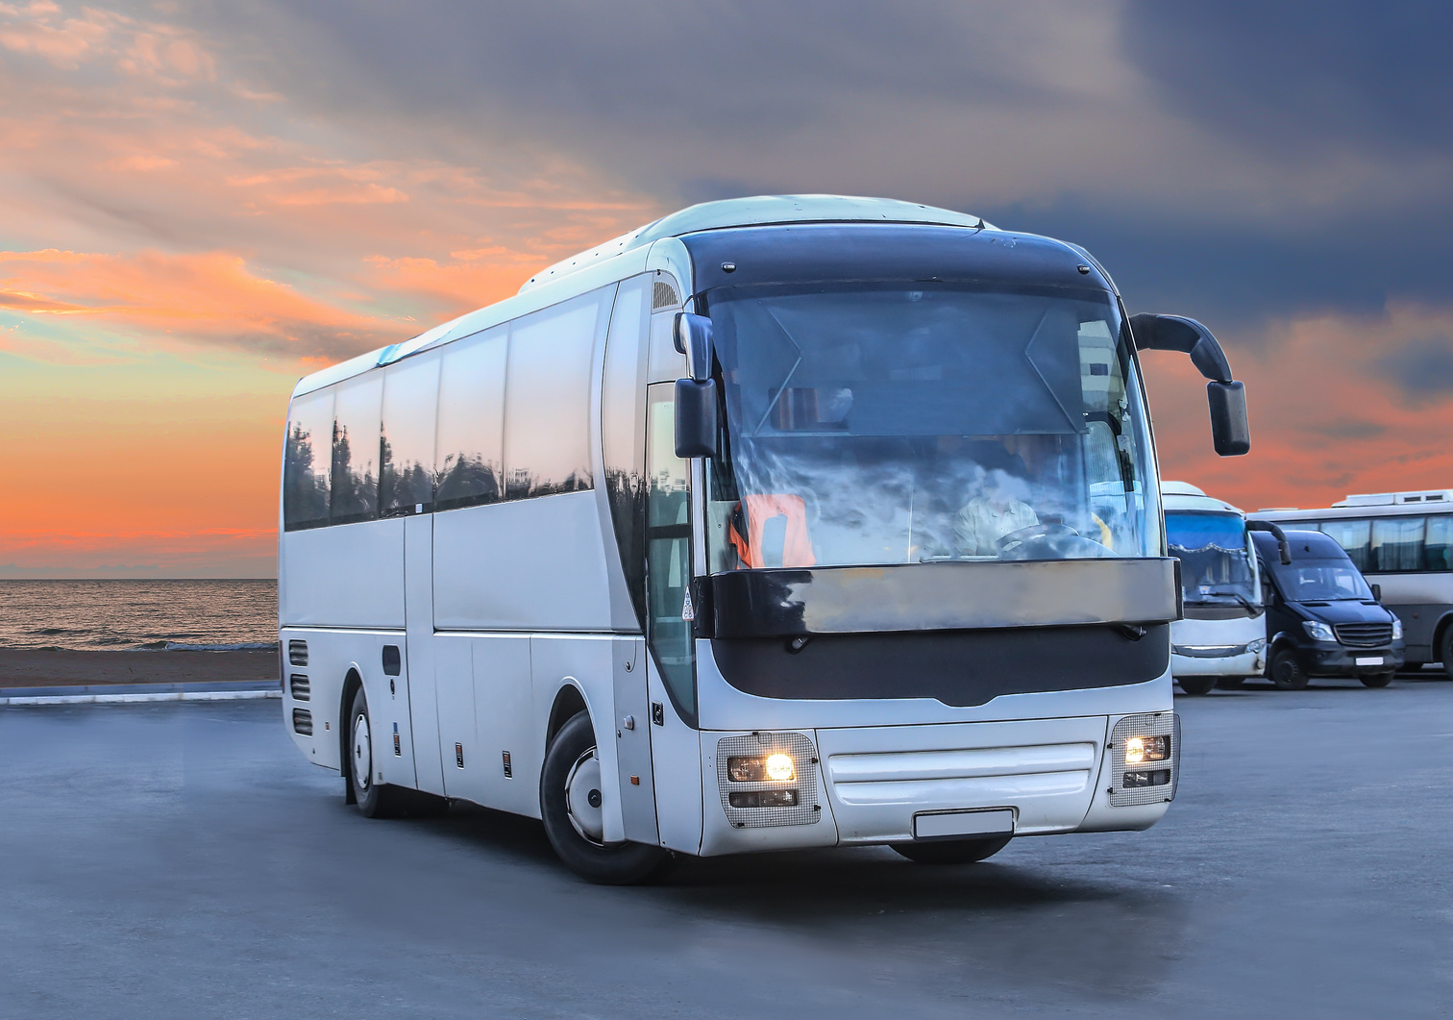
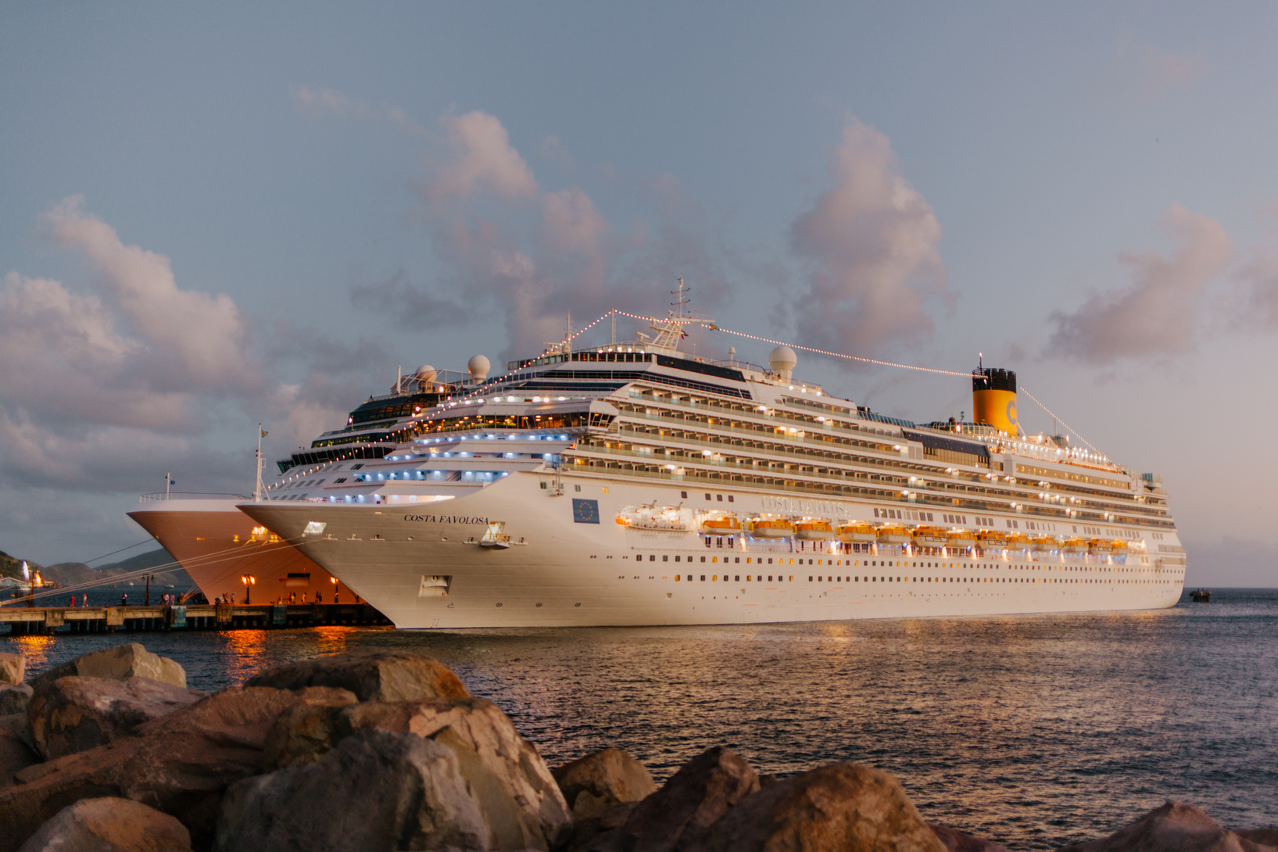




Transportation
Presentations are communication tools that can be used as lectures, speeches, reports, demonstrations, and more.
Land
Water
Air

Slide 6

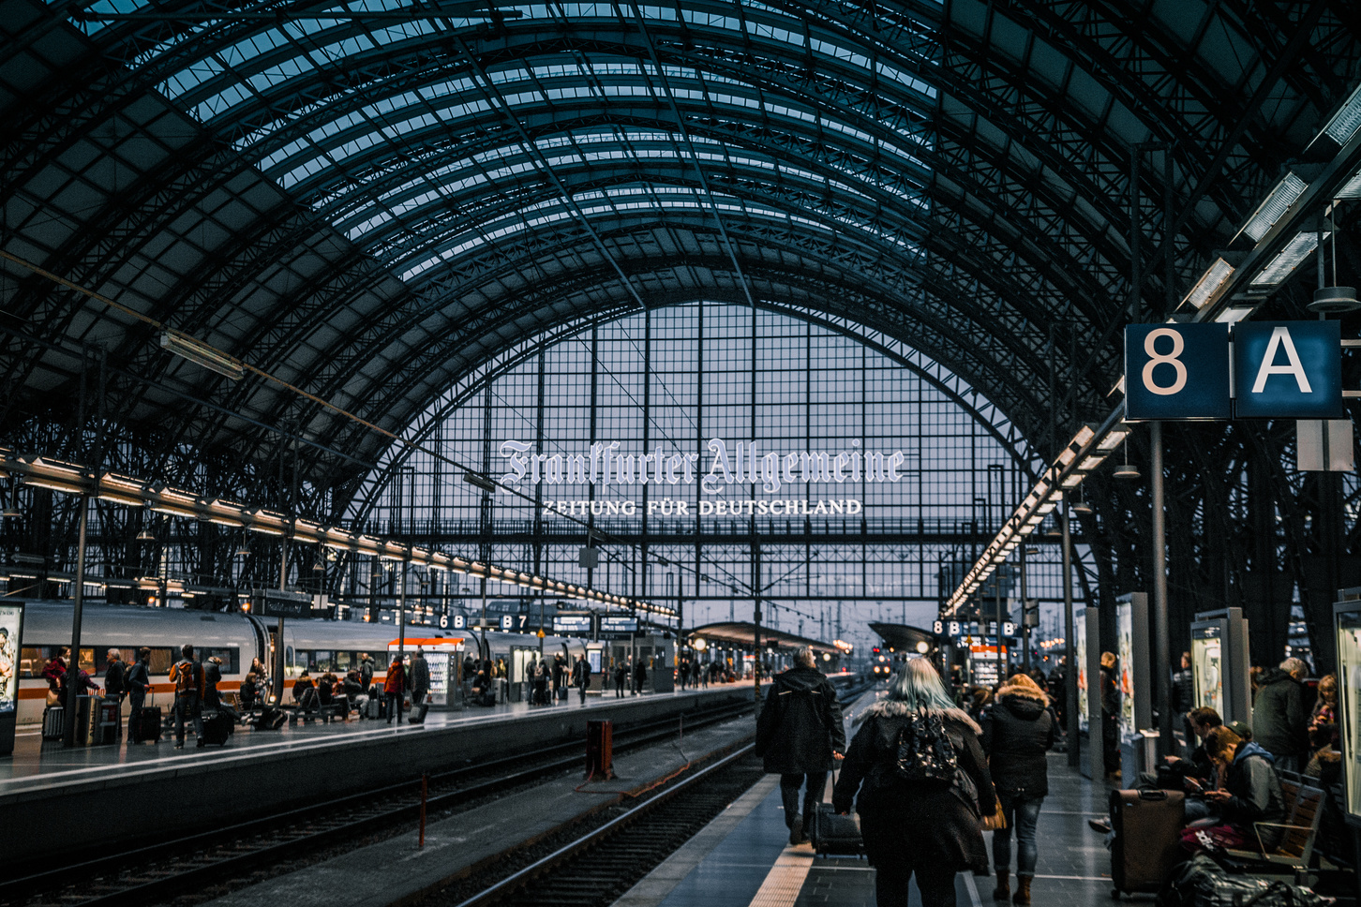
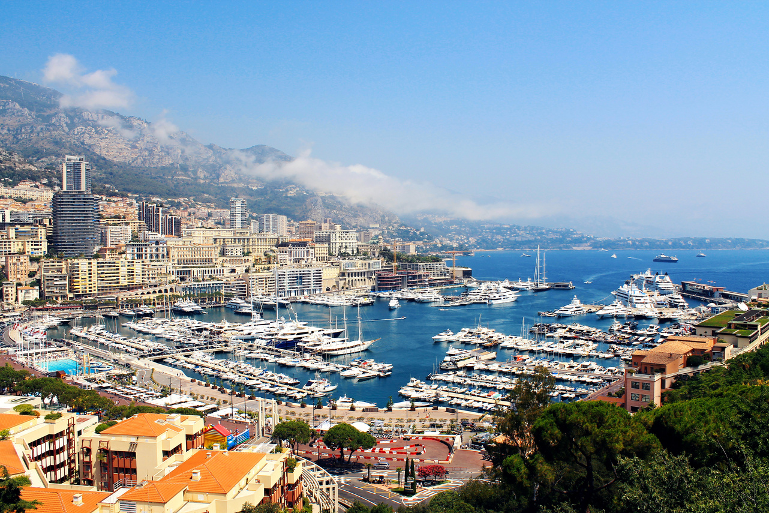

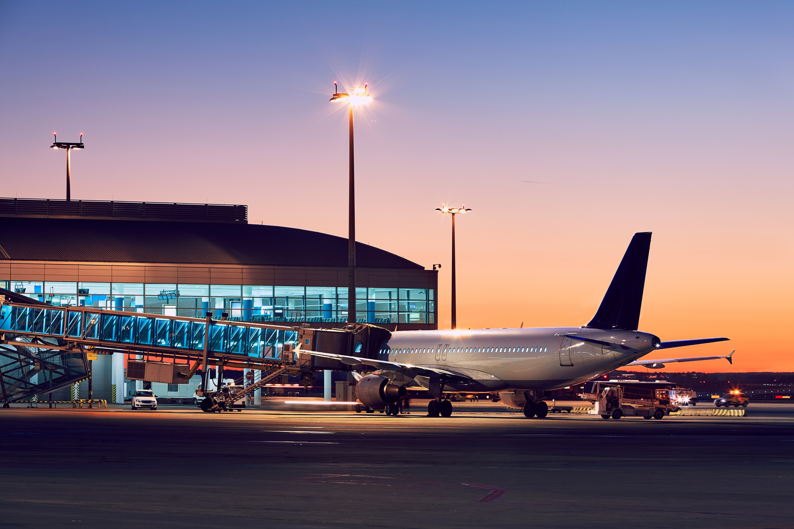
Presentations are communication tools that can be used as lectures, speeches, reports, demonstrations, and more.
Station
Port
Station & Ports
Airport

Slide 7
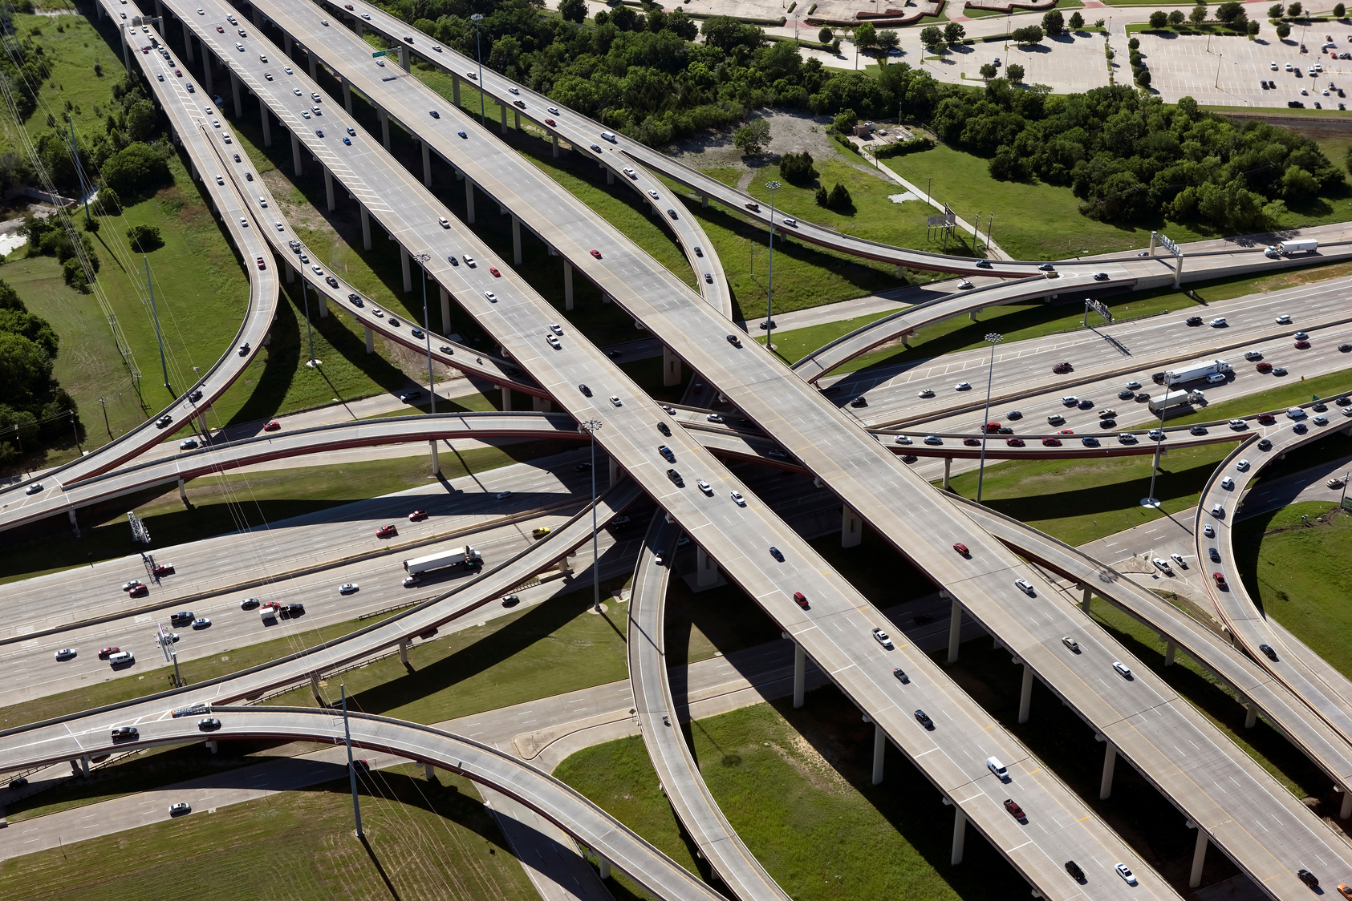

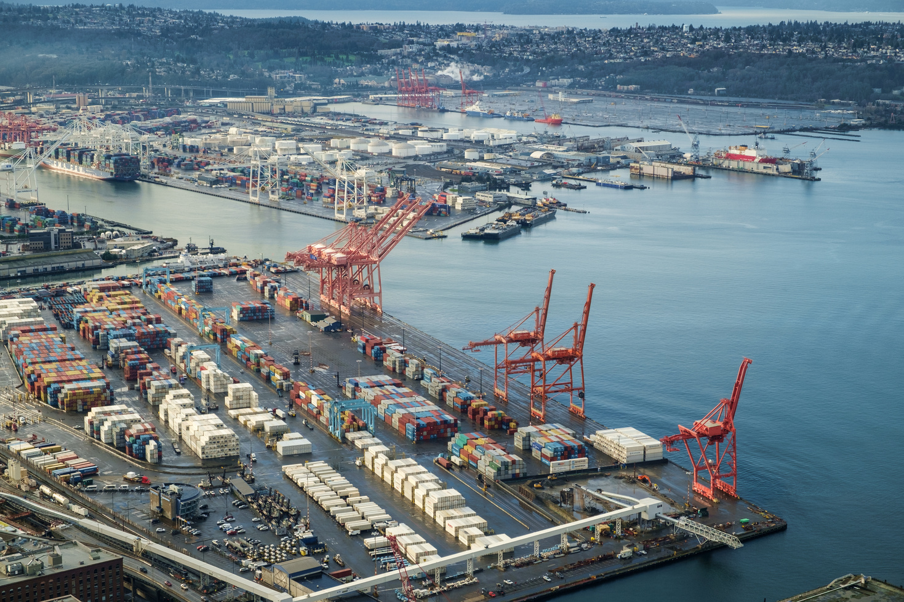

A.
B.
Quiz!
Station
Toll Road
C.
D.
which place does plane land?
Port
Airport

Slide 8

Answer: D
Presentations are communication tools that can be used as lectures, speeches, reports, demonstrations, and more.
Airport

Slide 9
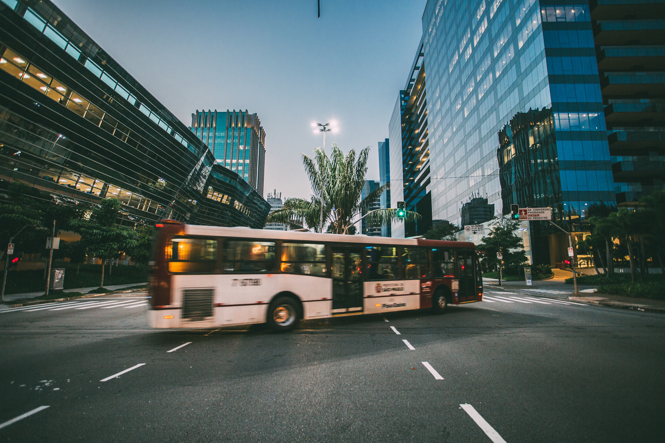
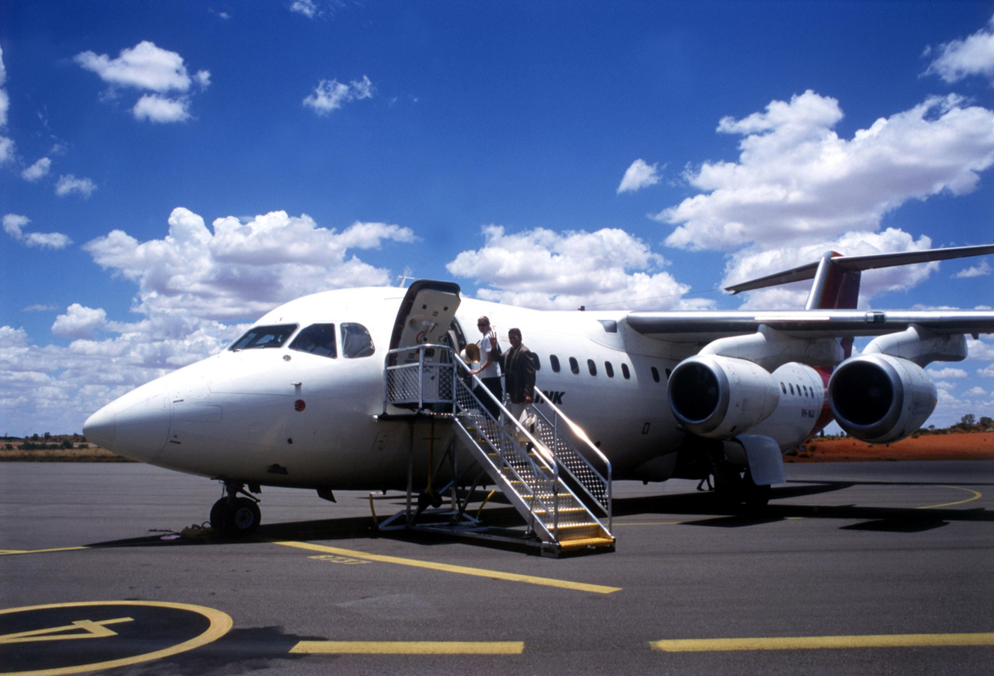
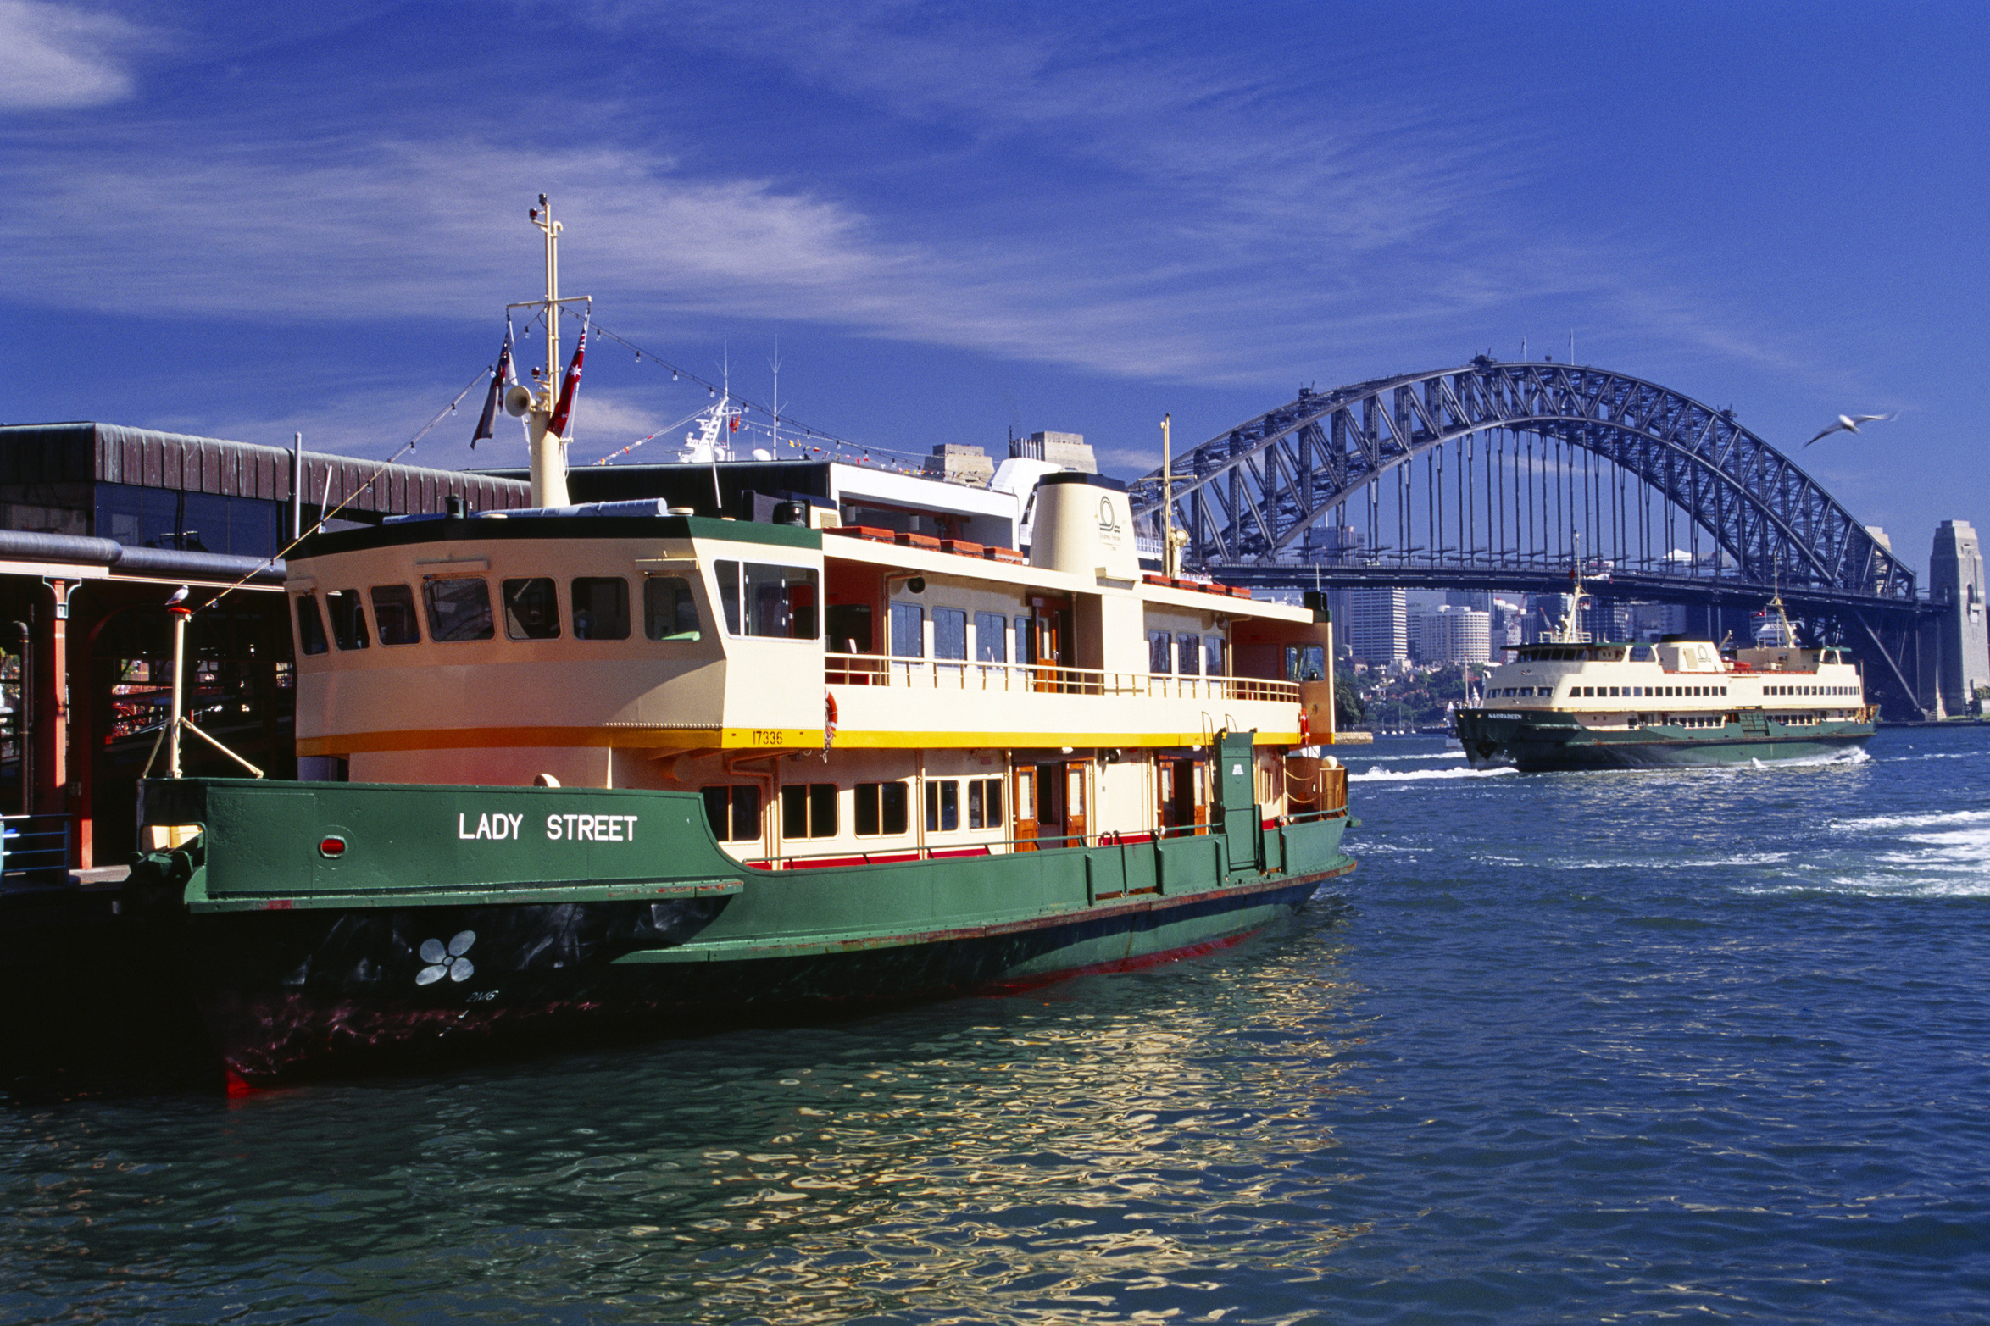
Conclusion
Presentations are communication tools that can be used as lectures, speeches, reports, demonstrations, and more.

Slide 10

Thank You!
Presentations are communication tools.
Created by
Mr. Chad Gibbons

